Slide 1


Slide 2
DAY 1
Introduction to Git

Slide 3


Day 1 - Starting with Git
Welcome to Day 1!
Our main goal here is to understand Git, GitHub, and code repositories.

Slide 4
Day 1 - Starting with Git
Day 1 Topics
Understanding git and GitHub
Installing Git
Creating GitHub Profile
GitHub Tour
Creating and Cloning a git Repository
GitHub Desktop and Extensions
Exercise and Solution

Slide 5
DAY 1
Let’s get started!

Slide 6
DAY 1
Git and Github

Slide 7

Day 1 - Starting with Git
Let’s cover a bit of history of Git and GitHub to fully understand the motivations behind the open source VCS software and the most popular company for using this VCS.

Slide 8
Day 1 - Starting with Git
Also just a quick note, you will see it stylized as git or Git.
Git typically refers to the entire project, while git is the actual program used.

Slide 9

Day 1 - Starting with Git
Git was originally created by Linus Torvalds in 2005.
Linus is famous for being the creator of the Linux kernel.
Linus created Git after another VCS called BitKeeper became proprietary.

Slide 10
Day 1 - Starting with Git
Linus developed the basic foundation of git in just 3 days!
If you want to view the source code, Git itself is hosted on GitHub:
https://github.com/git/git

Slide 11
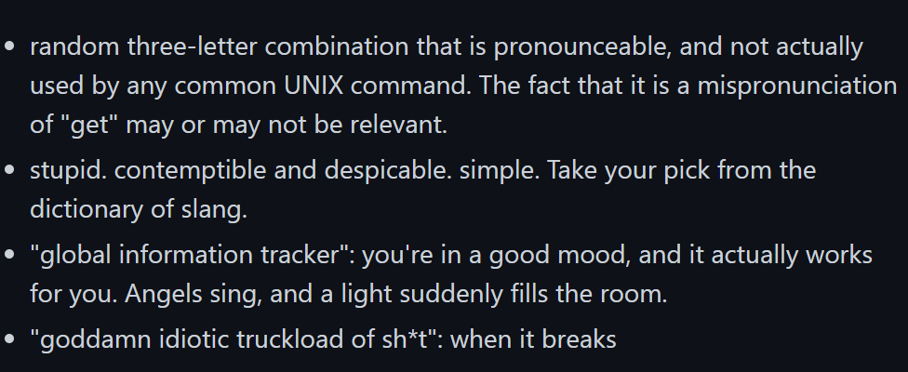
Day 1 - Starting with Git
Meaning of “git”:

Slide 12

Day 1 - Starting with Git
Now let’s quickly discuss the brief history of GitHub the company!

Slide 13
Day 1 - Starting with Git
GitHub was started in 2007 as an internet hosting service for software development and version control using Git.
While GitHub has many free tier features, including hosting of repositories, their paid features revolve around the needs of corporations, such as multiple people working on a private code repository.

Slide 14
Day 1 - Starting with Git
GitHub was acquired by Microsoft in 2018 for USD $7.5 billion.
Post acquisition there has been a deeper integration between GitHub and Microsoft products, including connecting to GitHub directly within VS Code, a code editor tool from Microsoft.

Slide 15
Day 1 - Starting with Git
Git is the open source software that actually manages the git commands as a VCS.
We will call it at the command line with commands such as: git push
GitHub is the online hosting provider, that can act as a machine connected to our local machine via the internet and host code in a repository for us.

Slide 16
Day 1 - Starting with Git
GitHub also provides many other features, especially graphical interfaces of many git features.
For example you can easily merge issues or view commits on the GitHub website, rather using the command line locally.
An online hosted repository also provides an ideal connection point between everyone working on the same project.

Slide 17
Day 1 - Starting with Git
All the features and git methods shown in this course will fall under the free tier of GitHub.
You should also know that you can now perform the commands with the GitHub Desktop Tool (a GUI for git commands) and the VS Code with GitHub extensions.

Slide 18
Day 1 - Starting with Git
There are actually many, many GUIs that have been created for Git, you can find the official list here:
https://git-scm.com/downloads/guis
This course focuses on understanding how to use Git at the command line, since its still most commonly used that way, however we will also show you how to perform commands with GitHub Desktop.

Slide 19
Day 1 - Starting with Git
You should still learn the git commands to fully understand how to use git, but make sure you also take advantage of the easy to use tools and extensions for using Git (especially with GitHub).
Personal Anecdote:
I find myself using GUI tools about 50% of the time and terminal commands the other 50%.

Slide 20
Day 1 - Starting with Git
Up Next:
Let’s install Git on to your computer!

Slide 21
DAY 1
Installing Git

Slide 22
Day 1 - Starting with Git
Let’s install git on to your computer!
The installation process will be slightly different depending on your Operating System.

Slide 23
Day 1 - Starting with Git
MacOS or Linux Users:
Congrats! You already have Git installed on your machine since it comes pre-installed as part of your OS.
To confirm this, open up a terminal and type:
git --version
>> git version 2.25.1 (Apple Git-128)

Slide 24
Day 1 - Starting with Git
MacOS or Linux Users:
If you wish to update or re-install git, you can do this by simply selecting the MacOS or Linux links on the official git website:
https://git-scm.com/downloads

Slide 25
Day 1 - Starting with Git
MacOS or Linux Users:
Now we’ll be editing text files for this course, which means we need a text editor.
If you’re in this course, we’ll assume you’ve used a text editor before, and often people have very strong opinions on a preferred text editor!

Slide 26
Day 1 - Starting with Git
MacOS or Linux Users:
Our suggested text editor for this course is VS Code:
https://code.visualstudio.com/
Its created by Microsoft and has direct integrations with GitHub and is one of the most popular text editors today.
You can follow along with any text editor you prefer however.

Slide 27
Day 1 - Starting with Git
Windows Users:
Our HIGHLY recommend text editor for this course is VS Code:
https://code.visualstudio.com/
Why HIGHLY recommended?
Windows + VS Code + GitHub
Upon installing git you will be asked to select a default editor, you’ll need VS Code installed to select it as default.

Slide 28
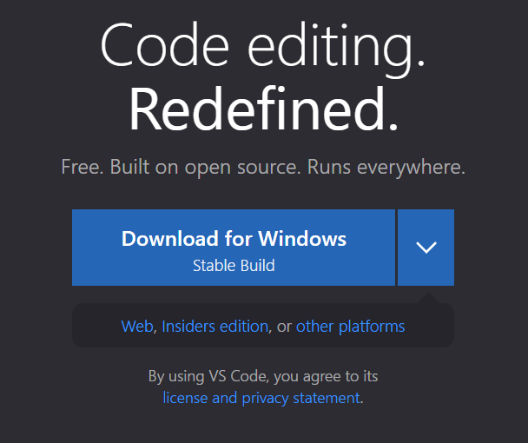
Day 1 - Starting with Git
Windows Users:
Go to:
https://code.visualstudio.com/
Download with Default Settings:

Slide 29
Day 1 - Starting with Git
Windows Users:
Next we’ll download git, go to:
https://git-scm.com/

Slide 30
DAY 1
GitHub Profile Setup

Slide 31
Day 1 - Starting with Git
Now that we’ve downloaded Git, let’s create a GitHub profile and also download the GitHub Desktop Tool for a GUI.
We’ll also show you how to set-up the VS Code GitHub extension.

Slide 32
Day 1 - Starting with Git
Take careful note of the user name and email address you register with at GitHub, ideally it will be the same username and email you configure git with locally.
We will configure git in the next lecture.
Let’s create an account at:
www.github.com

Slide 33
DAY 1
Configure Git

Slide 34
Day 1 - Starting with Git
So far we’ve:
Installed Git
Created a GitHub Account Profile
Installed GitHub Desktop and VS Code
What left for Day 1:
Configure Git Locally
Create a Repository
Explore VS Code Integrations
Exercise and Solution

Slide 35
Day 1 - Starting with Git
Take careful note of the user name and email address you register with at GitHub, ideally it will be the same username and email you configure git with locally.
We can technically use any username/email we want, but your history of “commits” (changes to code) will be saved in the public log of changes in the repository.

Slide 36
Day 1 - Starting with Git
In this lecture we will set-up a name and email address on our local installation of Git.
If you only ever used Git locally by yourself then this username and email would just be stored on your local historical logs.
However if you end up working with others and using GitHub, this information will be useful to identify who did what.

Slide 37
Day 1 - Starting with Git
You can check the current configuration with the commands:
git config user.name
git config user.email
The configuration commands will be:
git config --global user.name “user”
git config --global user.email “email”

Slide 38
Day 1 - Starting with Git
Let’s head over to our command line interface to set-up our Git configuration:
Git Bash
Terminal
Command Prompt

Slide 39
Day 1 - Starting with Git

Slide 40
DAY 1
Creating a Git Repository

Slide 41
Day 1 - Starting with Git
The main place we track changes and manage our files that are using Git is called a repository.

Slide 42
Day 1 - Starting with Git
The main place we track changes and manage our files that are using Git is called a repository.
Initial
Project
Add Code
Add
More Code
Add
More Code
Branch
Code
Merged
Version

Slide 43
Day 1 - Starting with Git
The main place we track changes and manage our files that are using Git is called a repository.
Initial
Project
Add Code
Add
More Code
Add
More Code
Repository
AKA “Repo”
Branch
Code
Merged
Version

Slide 44
Day 1 - Starting with Git
Let’s explore a public repository:
https://github.com/tensorflow/tensorflow
Initial
Project
Add Code
Add
More Code
Add
More Code
Repository
AKA “Repo”
Branch
Code
Merged
Version

Slide 45
Day 1 - Starting with Git
How can we create a Git Repository?
git init
This command initializes a Git Repository on your local machine.
You only need to run this command once per project.
git status
This command will report back the status of your Git repository.

Slide 46
Day 1 - Starting with Git
How can we create a Git Repository?
Upon creating a repository with git init you will create a hidden .git file.
The .git file is a hidden file that manages the versioning of the files inside the Git repository.

Slide 47
Day 1 - Starting with Git
Git inside a Folder/Directory:
Upon creating a Git Repository, all the folders/directories inside the top level Git Repository will also be part of that Repository, meaning all the changes are tracked.

Slide 48

Day 1 - Starting with Git
Git inside a Folder/Directory:
Upon creating a Git Repository, all the folders/directories inside the top level Git Repository will also be part of that Repository, meaning all the changes are tracked.
git init

Slide 49
Day 1 - Starting with Git
Git inside a Folder/Directory:
Upon creating a Git Repository, all the folders/directories inside the top level Git Repository will also be part of that Repository, meaning all the changes are tracked.
git init
.git

Slide 50
Day 1 - Starting with Git
Git inside a Folder/Directory:
Upon creating a Git Repository, all the folders/directories inside the top level Git Repository will also be part of that Repository, meaning all the changes are tracked.
.git

Slide 51
Day 1 - Starting with Git
Git inside a Folder/Directory:
Upon creating a Git Repository, all the folders/directories inside the top level Git Repository will also be part of that Repository, meaning all the changes are tracked.
git init
.git

Slide 52
Day 1 - Starting with Git
Git inside a Folder/Directory:
Upon creating a Git Repository, all the folders/directories inside the top level Git Repository will also be part of that Repository, meaning all the changes are tracked.
git init
.git
.git

Slide 53
Day 1 - Starting with Git
Git inside a Folder/Directory:
Upon creating a Git Repository, all the folders/directories inside the top level Git Repository will also be part of that Repository, meaning all the changes are tracked.
git init
.git
.git

Slide 54
Day 1 - Starting with Git
Git inside a Folder/Directory:
Upon creating a Git Repository, all the folders/directories inside the top level Git Repository will also be part of that Repository, meaning all the changes are tracked.
git status
.git

Slide 55
Day 1 - Starting with Git
How can we create a Git Repository?
We can also use the Graphical Interface with GitHub Desktop or we can even create a new repository online at www.github.com.
Then we can git clone this repository to our local machine.

Slide 56
Day 1 - Starting with Git
Let’s create our first local Git repository at the command line.
Then we’ll create a repository on GitHub and use git clone to clone it to our local computer.
We’ll need to set-up some tokens in order to clone private repositories.

Slide 57
DAY 1
Private Repositories
and Tokens

Slide 58
Day 1 - Starting with Git
We discovered we can easily clone other public repositories with the git clone command and then the HTTPS URL for the public repository.
Now let’s explore how to deal with private repositories we wish to clone.

Slide 59
Day 1 - Starting with Git
Option 1: Command Line:
Create Personal Access Tokens (PAT) on Github.com
When using the git clone command, reference the PAT.
Option 2: GitHub Desktop Tool GUI:
Open the Github Desktop Tool
Login with GitHub Username and PW
Clone Repo via GUI

Slide 60
Day 1 - Starting with Git
Clone Syntax with PAT:
git clone https://token@github.com/account/repo.git
Previously we used:
git clone https://github.com/account/repo.git

Slide 61
Day 1 - Starting with Git

Slide 62
DAY 1
Summary and Exercise

Slide 63
Day 1 - Starting with Git
It’s the end of Day 1, let’s review the main Git and GitHub related methods we now know:
How to Create Repository
Locally via Command Line
git init
Online via GitHub.com
Locally via GitHub Desktop Tool

Slide 64
Day 1 - Starting with Git
It’s the end of Day 1, let’s review the main Git and GitHub related methods we now know:
How to Clone a Repository
Public Repo from GitHub to our local machine via the Command Line
git clone
Private Repo from GitHub to our local machine via GUI and Command Line

Slide 65
Day 1 - Starting with Git
There is still a lot more to learn, we haven’t even shown you how to take a local repository and push it to GitHub yet, that will be covered tomorrow on Day 2!
Let’s conclude Day 1 with an Exercise

Slide 66
Day 1 - Starting with Git
Exercise Tasks:
Create a new Private Repository on GitHub.
Initialize your repository with README, license and gitignore.
Clone your Repository using the Command Line and a PAT.

Slide 67
Day 1 - Starting with Git
Exercise Solution:
This basically mimics the operations we did in the previous lecture, so we won’t duplicate work by creating a specific solutions video, but if you get stuck, review the previous lecture for a “solution”.

Slide 68
DAY 1
Exercise Solution

